Slide 1
Chapter 10
Credit and Risk*
*Thanks to Professor Steve Boucher for providing many of these slides.

Slide 2
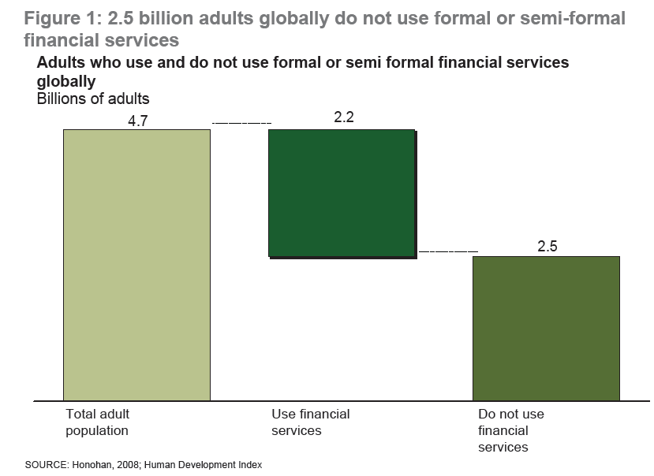
From Chaia et. al., (2009). http://financialaccess.org/sites/default/files/110109%20HalfUnbanked_0.pdf

Slide 3
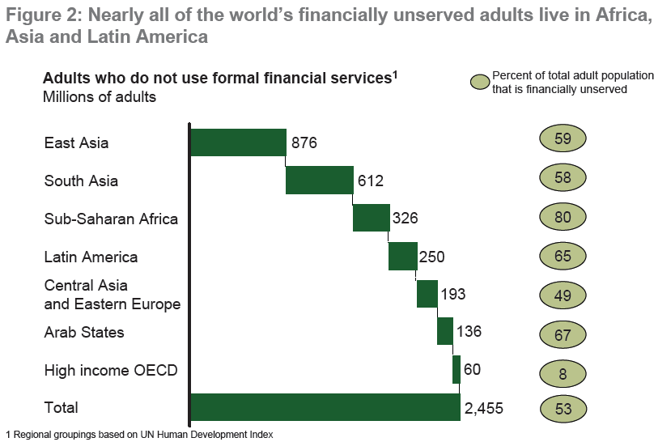
From Chaia et. al., (2009). http://financialaccess.org/sites/default/files/110109%20HalfUnbanked_0.pdf

Slide 4
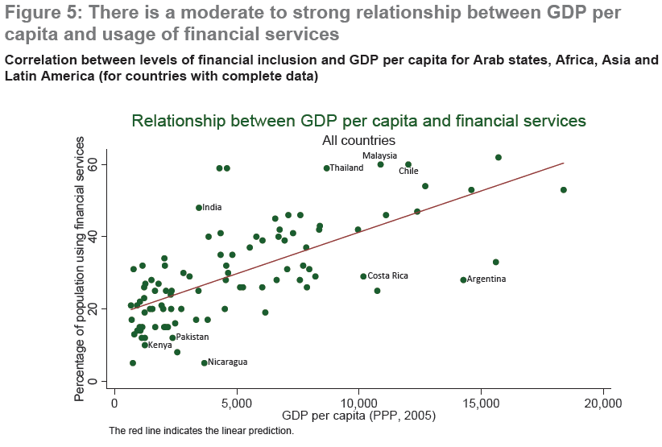
From Chaia et. al., (2009). http://financialaccess.org/sites/default/files/110109%20HalfUnbanked_0.pdf

Slide 5
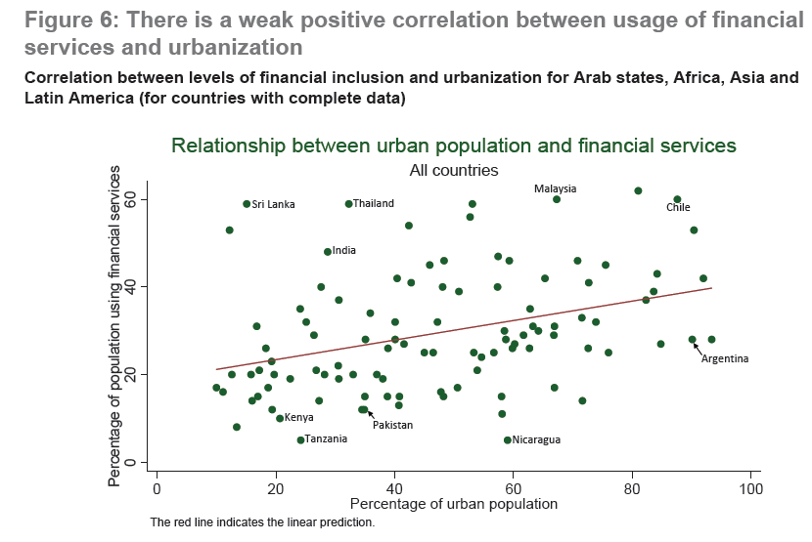
From Chaia et. al., (2009). http://financialaccess.org/sites/default/files/110109%20HalfUnbanked_0.pdf

Slide 6
Three Crucial Roles of Credit in Development
Credit allows you to get ahead (Credit for investment);
  Borrowing allows individuals with good ideas and other productive assets, but who lack liquidity, to realize productive investments and raise income.
Credit prevents you from falling behind (Credit for consumption);
  Borrowing allows households that experience a negative shock to maintain consumption and asset levels and preserve their ability to generate income.
  Thus credit can also be a form of insurance.
Credit shifts risk
  Default clauses (liability rules) define circumstances when borrower does not have to repay;
  Thus shifts some risk from borrower to lenders (who are more able to accept it);
  Can thus induce people to make high return, but risky investments that they otherwise would not make;

Slide 7
Some Empirical Puzzles
(“Imperfect Information and Rural Credit Markets: Puzzles and Policy Perspectives” by Hoff & Stiglitz),
Coexistence of formal and informal lenders, even though informal interest rates are much higher than formal rates.
Excess demand may exist. Some people are willing to pay the market interest rate (or more) for a loan, but they are denied )
Credit markets are segmented. Interest rates vary a lot even in nearby areas.
Formal lenders specialize where farmers have land title.
Notes:
Why should these be considered puzzles in perfect markets?
Note on inter-linkages: An inter-linkage occurs when two people simultaneously make two transactions AND the terms of each individual transaction would be different if they were “unbundled”.
Examples:
Large farmer lends money to landless worker so worker can eat during “lean” season. In addition, landlord agrees to hire the worker on his farm during the “peak” season.
Rice mill makes a loan to a rice farmer. In addition, rice farmer agrees to sell his rice output to the miller.

Slide 8
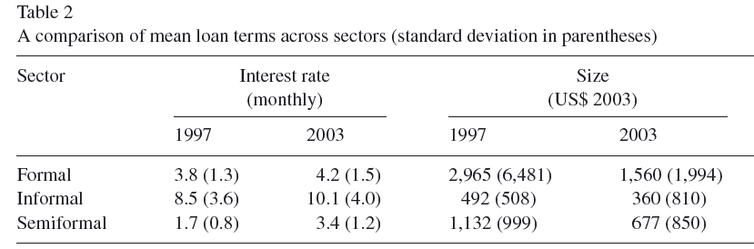
Some data from Peru
Source: “Credit constraints and productivity in Peruvian Agriculture,” Guirkinger and Boucher, Agricultural Economics, 29, 2008.

Slide 9
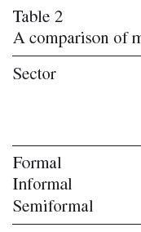
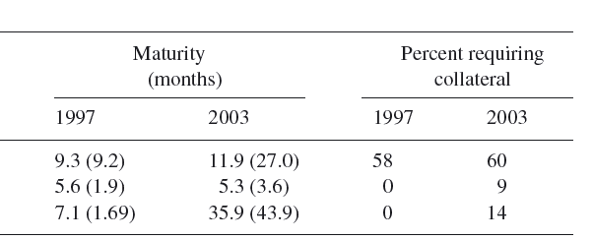
Some data from Peru
Source: “Credit constraints and productivity in Peruvian Agriculture,” Guirkinger and Boucher, Agricultural Economics, 29, 2008.

Slide 10
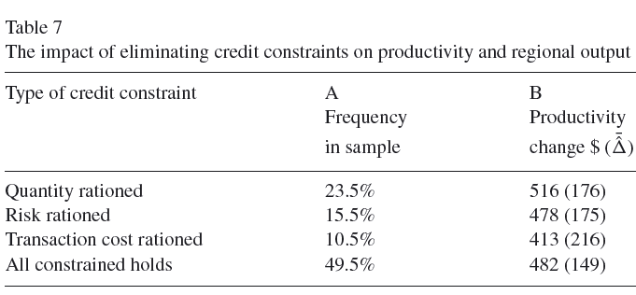
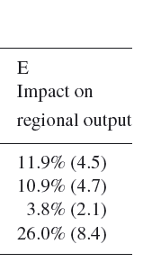
Some data from Peru
Source: “Credit constraints and productivity in Peruvian Agriculture,” Guirkinger and Boucher, Agricultural Economics, 29, 2008.

Slide 11
Outline for Today
I. Why is Credit not like a Potato? Theory of Credit Rationing
  Asymmetric Information in credit markets;
  Adverse selection and moral hazard;
  Potential for credit market imperfections, failure.
II. What can be done about credit rationing?
  Brief history of rural credit market policy in developing countries
  Micro-finance/Group lending
    What’s the Big Idea?
    Limitations and further policy options?
III. Information Asymmetries and Failures in Other Markets
  Risk and insurance
  Labor

Slide 12
Part I: Theory of Why Credit Markets Fail

Slide 13
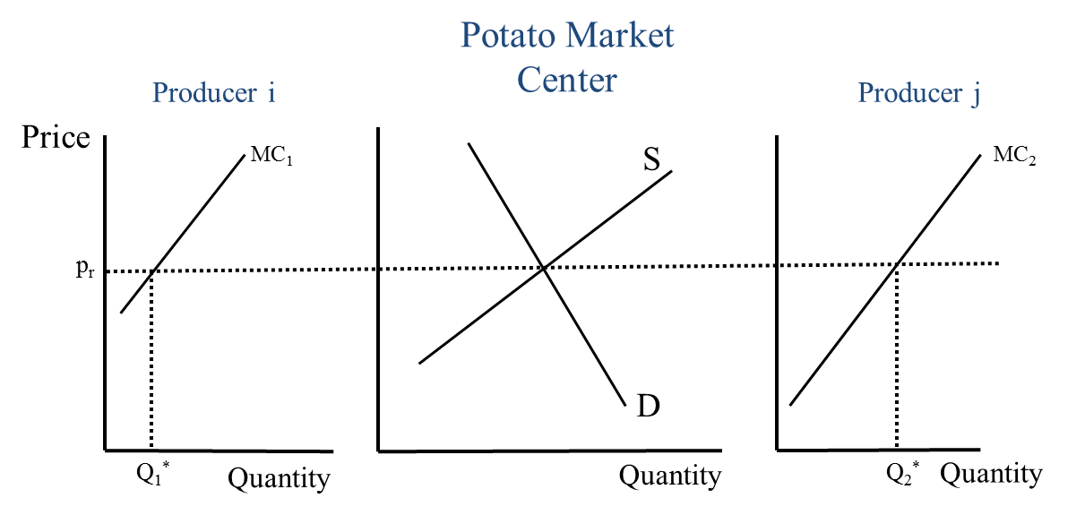
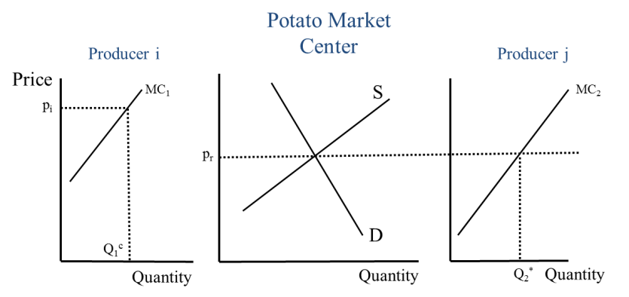
What is a Market Failure?
In General: A market failure occurs when economic actors are unable to get together to make efficiency enhancing trades.
Recall Meaning of Efficiency…
  No more potential gains from trade: All producers have same MC (= market price), all consumers have same MRS (= ratio of market prices for any two goods)
In Credit Markets: “A market failure occurs when a competitive market fails to bring about an efficient allocation of credit.” (Tim Besley)
Which brings us to our primary question…
Notes:
Efficiency enhancing trade makes at least one person better off without making anyone worse off.

Slide 14
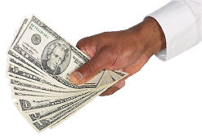
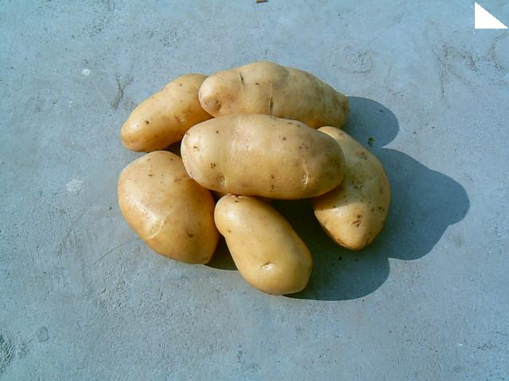
Why is credit different from a potato?
?
=

Slide 15
Reason #1: Credit is exchanged over TIME
Potato transaction is instantaneous
Credit transaction requires an inter-temporal exchange
Think about this a bit more carefully…

Slide 16
What is being traded in a credit transaction?
The inter-temporal use of resources
  Lender gives up the use of resources today in return for a promise to get resources tomorrow.
  Borrower receives the resources today in return for a promise to pay them back tomorrow.
So turning things around a bit, we can think of…
  Borrower is “selling” a promise that he will give the lender resources to use in the future. In return he gets to use the resources today.
  Lender is “buying” this promise that the borrower will repay resources in the future. In return, he gives up the use of resources today.
This implies that…

Slide 17
Reason #2: Repayment is UNCERTAIN
Involuntary default:
  Borrowers (farmers, business owners, …) face lots of risk;
  Borrower may be unable to repay because of negative shock;
  Is this a concern to lender?
  Not necessarily…if she can correctly evaluate the risk of each borrower she can charge higher i.
  What things determine risk??
  “Intrinsic” characteristics of the investment AND borrower’s actions.
Voluntary default:
  Borrower is able to repay but chooses not to
  This is definitely a concern to the lender!
This brings us to…

Slide 18
Reason #3: Information is Asymmetric
A potato is a potato is a potato…You know what you’re getting when you buy it, so information is symmetric.
Not the case with credit!
Recall: Lender “buys” a promise of resources to be delivered in the future.
What does the quality of this good depend on?
The probability that the borrower delivers!
This, in turn, depends on:
  Characteristics of the borrower (seller of the promise);
  Actions of the borrower (seller of the promise).
Lender has less information about the seller than the seller himself. So information is asymmetric.

Slide 19
Implications…
Time, uncertainty and information asymmetries imply:
  Credit contracts must be written, explicitly or implicitly (don’t need a contract to buy a potato!)
  Information flow is critical
  Legal enforcement is critical
Credit markets may be imperfect
  Credit rationing may occur; (somebody define this???)
  Some people with good investment opportunities will not make those investments because of poor access to credit
Institutions are KEY in credit markets (for example…??)
  Court system
  Credit bureaus
  Property registry

Slide 20
“Imperfect Information” Paradigm
Field of “Economics of information” emerges in the 1980’s.
Stiglitz, Akerloff, and Spence win Nobel prize in 2001 – primarily for economics of information.
Powerful framework for understanding imperfections in many markets where contracts are critical.
Revolves around two basic notions:
  Adverse Selection
  Moral Hazard
  These two concepts will help answer the question:
    Why won’t the lender raise the interest rate to eliminate excess demand (get rid of credit rationing)?

Slide 21
Asymmetric Information in Credit Markets #1
Adverse Selection
“A Tale of Two Types”

Slide 22
Adverse Selection
General: A situation in which the seller has relevant information that the buyer lacks about some characteristic of product quality.
Credit Markets: Borrower has greater information about his own project – and thus the probability of default -- than lender.
  Borrower is “seller” of promise of future payment;
  Quality of the promise depends on default probability;
  Borrower knows more about his own default probability than lender.
Implication: The lender may be unwilling to raise the interest rate even if there exists excess demand.
Why? Because, by increasing the interest rate, the lender may adversely affect the quality of the applicant pool and thus lowers his own profit.

Slide 23
Problem Setup
You’re a loan officer:
  Man walks in the door and says...
  “I’m Honest Abe.”
  I’ve got a “sure thing” yielding 50% rate of return
  I need $1,000 to finance it.
You know:
  There are 2 types of borrowers in the world:
    “Honest Abe” always repays the loan.
    “Slick Willy” takes the money and runs (defaults).
  You also know: Population is equally split across the 2 types
    (i.e., randomly pick someone from the population → 50% chance Abe; 50% chance Willy)
Your problem:
  You can’t observe a borrower’s true type
  Slick Willy may pretend to be Honest Abe

Slide 24
Notation
Define:
  i = interest rate (.05 → 5% interest rate)
  R = loan repayment (This is lender’s revenue)
  L = loan principal. Assume it is $1,000. (This is lender’s cost)
  π = Lender’s profit.
Objective: Find the interest rate, i, that allows the lender to earn zero expected profit.
  Why zero expected profit?
So, the lender’s profit is just: π = R – L
  R: Amount he gets repaid (revenues)
  L: Opportunity cost of the money he lent out (cost)
π is a Random Variable. WHY?
  When he loans out the money, he doesn’t know if he will get the money back.
  i.e., the value of repayment, R, is a random variable.

Slide 25
Lender’s Expected Profit: E(π)
E(π) = E(R) – L
So we need to figure out what E(R) is:
E(R) = Pr(Borrower is Abe)*(Repayment if Abe) + Pr(Borrower is Willy)*(Repayment if Willy)
E(R) = (1/2)*[(1+i)*1,000] + (1/2)*$0
E(R) = (1/2)*[(1+i)*1,000]
  Makes sense: expected revenue is total repayment when the borrower is an “Abe” times probability the borrower is an “Abe”.
Then, since L = 1,000, the lender’s expected profit is just:
E(π) = E(R) – L = (1/2)*[(1+i)*1,000] - 1,000

Slide 26
Equilibrium Interest Rate
Perfect Competition → E(π) =0
E(π) = (1/2)*[(1+i)*1,000] - 1,000
Thus the equilibrium interest rate must satisfy:
0 = (1/2)*[(1+i)*1,000] - 1,000
500*(1+i) =1000 → 1+i = 2 → i = 1
Thus, must set 100% interest rate!

Slide 27
But that’s a problem...Abe’s r.o.r. is only 50%!
If I offer 100% interest rate, what will happen?
What will Abe do?
  Won’t take the loan
What will Willy do?
  Will take the loan
Thus the lender is left with only “Slick Willy” types in the market.

Slide 28
Summary of Adverse Selection
Borrowers have greater information than lender
Specifically, they know their own “type”
Bad types (Willy) may pretend to be Good (Abe)
Lender knows this and must charge high i
If i is too high, market collapses
  Good types drop out
  Lender knows only Bad types are left, so won’t lend
Market Failure!! Profitable investments aren’t made
QUESTION: What would happen if there were “Symmetric” information?

Slide 29
Asymmetric Information in Credit Markets #2
Moral Hazard
“A Tale of Two Actions”

Slide 30
Moral Hazard
General: A situation in which the seller has relevant information that the buyer lacks about some action that they (seller) take that affects product quality.
Credit Market: Borrower has more information about what he does (actions he takes) with the money -- and thus also about the probability of default -- than the lender.
Implication: The lender may be unwilling to raise the interest rate even if there exists excess demand.
Why? Because by increasing the interest rate, the lender induces the borrower to do things that reduce the probability of repayment and thus lowers his own profit.

Slide 31
The Setup
Again, you’re a loan officer
Only 1 type of borrower: Farmer Jimmy
2 possible actions (techniques)
Technique 1: Grow safe regular peanuts (RP)
  Invest $1,000
  $1,200 in revenues with certainty
  Profit = 1,200 – 1,000 = $200
Technique 2: Grow risky salted peanuts (SP)
  Invest $1,000
  20% of time successful, earning $2,000 in revenues
  80% of time failure, with $0 revenues
  E(Profit) = (.2)*(2,000) + (.8)*(0) – 1,000 = -600

Slide 32
Loan contract says:
  Repay if harvest is successful
  Default (pay nothing) if harvest fails
As loan officer, you think:
  If I charge i, what will Jimmy do?
So, what does Jimmy do?

Slide 33
Jimmy compares expected profit under two techniques.
Recall, in general, E(Profit) is:
E(Profit) = Pr(Success)*(Profit if success) + Pr(Fail)*(Profit if fail)
If he chooses Regular Peanuts (RP):
  E(Profit|RP) = 1,200 – (1+i)*1,000 = 200 – 1,000i
If he chooses Salted Peanuts (SP):
  E(Profit|SP) = .2*[2,000 – (1+i)*1,000] + .8*0
  E(Profit|SP) = 400 – (1+i)*200 = 200 – 200i
So, Jimmy will always choose SP!

Slide 34
Back to the lender’s decision…
Knowing this, what do you, the lender, do?
Well, let’s see what the lender’s profit looks like:
  E(π|SP) = E(Repayment|SP) – 1,000
  E(π|SP) = .2*(1+i)*1,000 + .8*0 - 1,000
  E(π|SP) = 200*(1+i) - 1,000
So what interest rate must you charge to break even?
  Set E(π|SP) = 0:
  200*(1+i) - 1,000 = 0 → 1+i = 5 → i = 4
So, you must charge 400% to break even
Would Jimmy want this loan?
E(Profit|SP) = .2*[2,000 – (1+4)*1,000] = -600
Again, that’s a problem. Loan market collapses.

Slide 35
Summary of Moral Hazard
Borrowers have greater information than lender.
Specifically, they know their “actions”.
Borrower may take action that lender doesn’t like (e.g. riskier technique).
Lender knows this and may charge high i.
If i is too high, market collapses.
Market Failure!! Profitable investments aren’t made.
What would happen if there were “Symmetric” information?

Slide 36
Part II: Institutional and Policy Responses to Asymmetric Information

Slide 37
How do lenders deal with Asymmetric Information? (Hoff and Stiglitz)
Indirect Mechanisms (IM): Contractual terms that provide incentives to potential loan applicants and borrowers in a way that reduces MH and AS.
Direct Mechanisms (DM): Actions taken by lenders to minimize MH and AS by directly addressing information asymmetries.

Slide 38
IM#1: Interest Rate
Interest rate is most obvious contract term;
We’ve already seen that if lender sets interest rate too high he may…
  Lose good types from applicant pool;
  Make borrowers take riskier actions;
By carefully adjusting interest rate, lender can partially control both adverse selection and moral hazard.

Slide 39
IM #2: Loan Size (progressive lending)
Basic idea: Start out offering small loan;
If repaid, offer larger and larger loans;
Addresses Adverse Selection:
  Lender can identify really bad types as those who default on the first loan.
  Cost of identifying bad types is low because loan size is small.
Addresses Moral Hazard:
  The promise of larger future loans provides incentives for the borrower to behave well (repay).
Any problems?
What happens to incentives as loan size gets larger?

Slide 40


IM #3:
Threat of Termination
If borrower defaults, deny future access to loans.
Addresses MH: Again, provides incentives to behave well.
Any problems?
  Can lender deny access to other lenders?
  What if default was legitimate?

Slide 41
IM #4: Collateral
Addresses AS: Risky types won’t apply because the probability of losing their collateral is high.
Addresses MH: Threat of losing collateral provides incentives for borrowers to behave well.
Any problems?
  Many people don’t have acceptable collateral;
  Risk rationing: People with good projects may not undertake them because collateral-based credit contracts force them to bear too much risk.
  Suggests that insurance market failures can spill-over into credit markets.

Slide 42
What types of assets make good collateral?
Valuable to borrower (very important) and to the lender (not as important).
What are desirable characteristics?
  Immobile (or really small…so lender can hold it);
  Quality (value) not subject to moral hazard;
  Property rights well defined and easily transferable.
What are some examples of collateral assets?
  Titled land/house/business;
  Jewelery;
  Machinery/vehicles;
  Standing crop (harvest);

Slide 43
Limitations to Collateral in rural areas of LDC’s
Poor people don’t have many assets!
The ones they do have may not be acceptable to banks (What assets do the poor own?);
Transactions costs of posting collateral are high;
Even if they have assets that banks accept, they may not use them (role of risk);

Slide 44
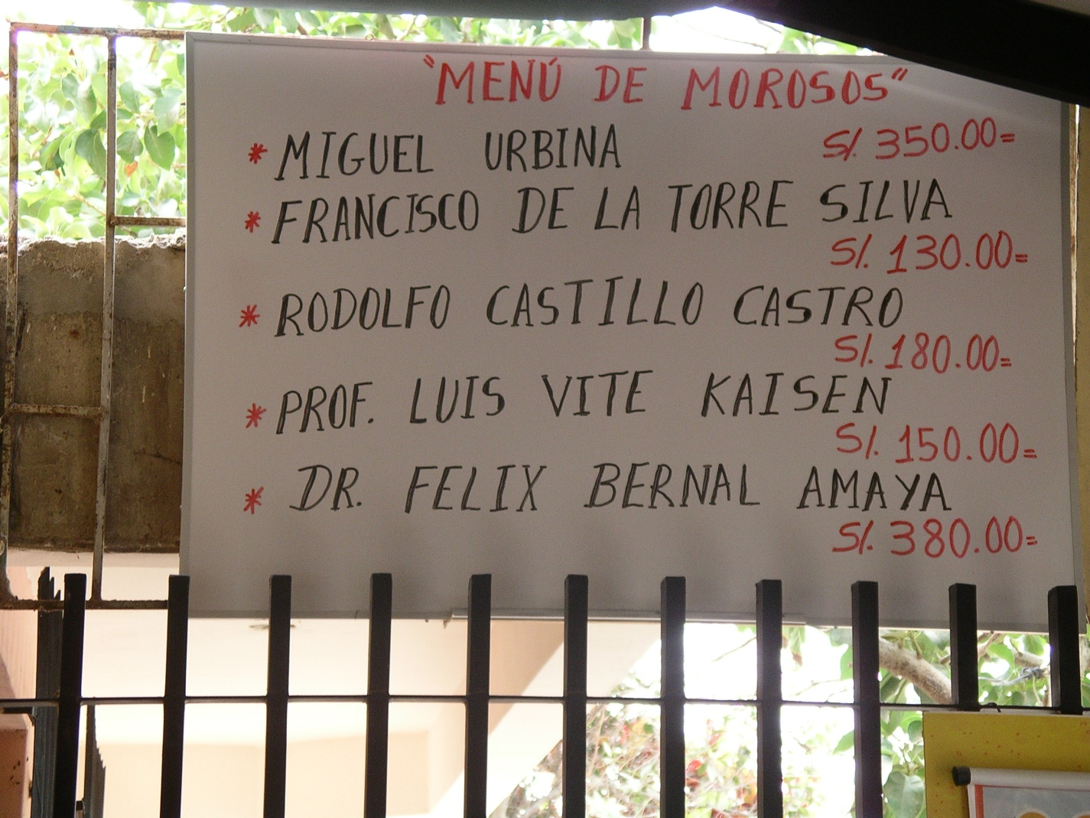
Reputation as a Collateral Substitute?
How might this work?
  “Debtor’s Menu” & “The men in the yellow suits”

Slide 45
Direct Mechanisms
What do we mean by “direct mechanism”? Examples?
Screening (ex-ante)
  Loan application forms;
  Investment project plans;
  Loan officer inspects farm, business…
  Loan officer interviews family and neighbors;
  Consult credit bureau (if it exists);
Monitoring (ex-post)
  Visit borrower (or farm/business) to check on progress of the project;
  Show up right before harvest time!

Slide 46
Role for Government??
Given the potential for credit rationing (especially among the poor), what should government do?

Slide 47
1950’s – 1980’s:
Active involvement in allocating credit (Big Idea)
Policies:
  Directly lend government funds via State Development Banks;
  Require commercial banks to lend certain fraction of portfolio to “target” sectors (ag);
  Impose interest rate ceiling;
Results:
  Disaster (with a few exceptions…)
  Default rates excessive…often >75%
    Govt. is no better at solving information problems than banks!
    Decisions driven by politics and rent seeking.
  Contributed to hyper-inflation
  Artificially low interest rates impeded deposit mobilization

Slide 48
1990’s: Financial Liberalization
Policies:
  Shut down development banks;
  Liberalize interest rates;
Results:
  Helps stabilize economy (lower inflation and helps restor balanced budget);
  But…credit access not much improved…especially for rural poor.

Slide 49
2000 and beyond:
Second Stage of Market Oriented Reforms
Policies:
  Land market liberalization (Eliminate land rental and sales restrictions);
  Property rights reform and titling programs;
  Strengthen regulatory capacity of the state over financial institutions;
  Strengthen insurance markets and risk management capacity of rural households (next week);
  Build/Support credit bureaus;
  Invest in legal/court system to reduce transaction costs in contract enforcement;
  Support alternative financial institutions…MICRO CREDIT.
KEY: State supports credit markets by correcting distortions, externalities or failures in complementary markets.
Results:
  ??? Too early to tell ???

Slide 50
What is Micro-Credit?
The provision of very small (micro) loans, typically less than $100
Loans made by institutions (informal lenders have always done this!);
Target clientele:
  Poor: People below or near the poverty line;
  Excluded: Those traditionally excluded from the formal credit market (banks);
  Entrepreneurs: Those who have small-scale (typically informal) businesses.
Loans typically made…
  …without collateral;
  …to women;
  …to groups.
Micro-credit is just one part of micro-finance;
  Includes other financial services to the poor
  Savings, insurance, financial education

Slide 51
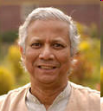
Micro-Credit: Brief History
Heterogeneous history from Asia, Africa & Latin America.
Most commonly associated with Grameen Bank in Bangladesh
  Started in 1976 by Muhammed Yunus;
  Offered $27 loan to 42 families;
  Becomes formal bank in 1983;
  By 2007 has had 7.4 million borrowers, $6.3 billion in loans.
  Vast majority of borrowers are women;
  Repayment rates (claimed) 95%.
Grameen methodology replicated and spread throughout the world…including the US.
2005 declared “International Year of Microcredit”
Yunus wins Nobel Peace prize in 2006

Slide 52
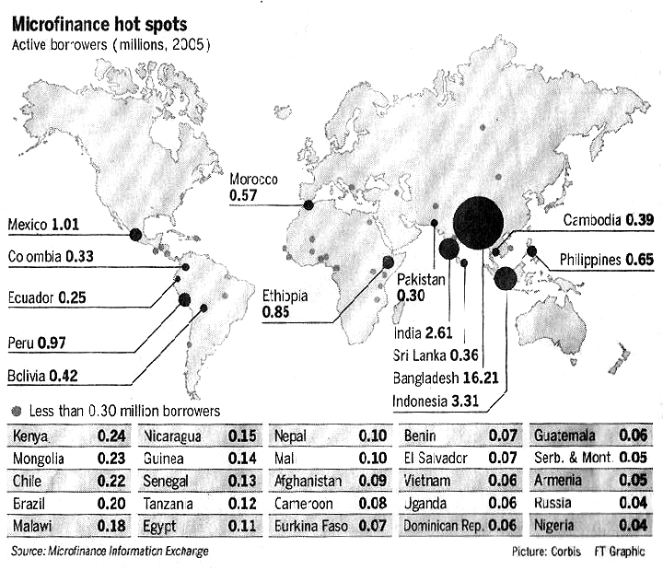

Slide 53
Basic Micro-finance Methodology
Borrowers self-select (choose each other) into borrower groups (typically 5);
No collateral is required;
Each member is responsible for their own loan;
But…if one member doesn’t repay, the entire group is denied access to loans in the future (joint liability);
Loan repayments made jointly and with high frequency (typically weekly or monthly);
In case of Grameen, many other social components…

Slide 54
The Economic Logic behind Micro-Credit
How does Grameen-style micro-credit address asymmetric information problems?
Self-selection into borrower groups: Utilize member information advantage to address Adverse Selection;
  Good types choose other good types. Thus they pay a lower “effective” interest rate because there is lower probability that they have to cover for somebody.
  Bad types are left with other bad types. They pay a higher “effective” interest.
  The (single) interest rate charged to all groups is lower than the interest rate the lender would have to charge on loans to individual borrowers. (because even in “bad” groups, members cover each other)
  Thus, the lower interest rate allows Good types to stay in the market.
Joint liability: Provide incentives for members to monitor themselves and, again, take advantage of members access to information about each others’ actions & ability to punish (social sanctions). This combination helps address Moral Hazard.
Bottom Line: Micro-Lenders design contracts that take advantage of borrowers’ information advantages.
  Contracts are designed so that borrowers themselves have incentives to overcome the asymmetric information problems that banks are not able to overcome.

Slide 55
Limitations & Critiques
It’s really hard to do!
  For every Grameen-style success, there are 10 failures.
  Lack of human capital, corruption, …
It’s expensive! Average interest rates = 30 – 40%
Most success stories have needed subsidies (sometimes large) to get started;
  This cost is often not factored in. Is it best use of scarce public money??
Very susceptible to covariate shocks (drought, flood).
Built-in problem with borrower “graduation”.
It’s a great story to tell if you like capitalism and status quo…but is it really addressing deeper/structural causes of poverty? (inequality, lack of infrastructure, poor education systems, poor health care systems…)

Slide 56
Additional Resources
Micro-finance Gateway
  http://www.microfinancegateway.org
Financial Access Initiative
  http://financialaccess.org
Readings from Jonathan Morduch
  The Economics of Micro-finance. Morduch & Armendariz de Aghion. 2005.
  “The Micro-finance Promise”. Journal of Economic Literature. 37(4). 1999
  “The Micro-finance Schism.” World Development. 28(4). 2000
Critical View
  What’s Wrong with Micro-finance? Dichter & Harper. 2007.

Slide 57
Part III: Risk and Insurance

Slide 58
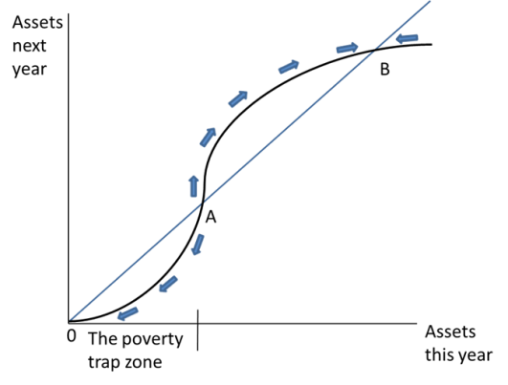
Implications of Risk and Uncertainty: Poverty Traps
Risk can keep people in poverty traps
  Getting out of poverty trap requires steps that would be too risky (higher returns mean higher risk)
  Ex-ante risk coping: diversify to reduce income risk (but lose gains from specializing)
Risk can force people into poverty traps
  Can’t recover from temporary setbacks (drought, illness, death of an animal)
When we see people (or countries) stuck in poverty traps, we tend to look immediately for underlying market or institutional failures (i.e., in credit or insurance markets)

Slide 59
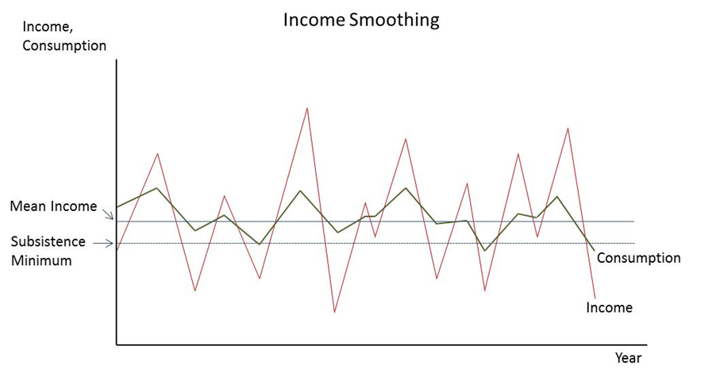
Keeping Food on the Table: Consumption Smoothing
Risk makes income volatile
…and consumption, too, unless you have ex-post coping mechanisms
  Sell assets (e.g., animals); fallback activities (e.g., migration); beg thy neighbor
  But covariate risks mean you buy high, sell low (see boxes) and your neighbor may not be able to help you out

Slide 60
A Primer on Insurance
What is being transacted in an insurance contract?
  Resources across states of nature;
  Insurer says:
    If your harvest fails (bad state of nature) I’ll pay you
    If your harvest is high (good state of nature) you pay me
The insurer’s profitability depends on:
  The probability he must pay out a claim
  The size of the claim

Slide 61
Asymmetric Information and Insurance
Asymmetric Information: The insurer knows less than the insured about:
  His intrinsic riskiness (TYPE).
  The things he does that affect the probability of an insurance payout (ACTIONS)
  Damages
  If the cost of overcoming this is too high, the insurance market fails
What two problems do information asymmetries lead to?
  Adverse Selection
    Riskier types are more likely to demand insurance
    If insurer bases premium on average riskiness, low risk types leave the market
  Moral Hazard
    The greater the insurance coverage; the less incentive to act in ways that reduce risk
    …so the probability of the insurer having to make a payout increases

Slide 62
Solutions
Formal insurance: Deductibles and Co-payments
  Provides incentive for farmer to “do the right thing” by making him bear some of the risk of his own actions
  Drawback: The higher is the deductible, the less risk is reduced
Informal insurance
Index insurance

Slide 63
Informal Risk Sharing Arrangements
(IRSA)
Local people (family, friends, villagers) have good information about each others’
  Types
  Actions (Similar logic as micro-finance)
Thus they can insure each other (I help you if your crop fails)
Limitations:
  Information is not perfect; enforcement can be a problem
  Good for idiosyncratic risks but not very useful against covariate risks (earthquakes, droughts, floods; why?)

Slide 64
Index Insurance
Insurance payouts are based on some external index
  …correlated with farmers’ yields, but
  …exogenous to farmer’s characteristics and actions
  How does this solve adverse selection and moral hazard?
Examples:
  Rainfall, water level in a reservoir
  Satellite imagery (vegetative index)
  Area yields (avg. yields in a specified area)
Insured farmer gets indemnity payment when the index falls below a critical level (strikepoint)
Primary objective: to mitigate covariate risk (i.e., risks that simultaneously affect many people in a region)
  Won’t help with idiosyncratic risk

Slide 65
Challenges to Index Insurance
Need a good index
  Is the index tightly correlated with farmer’s yields?
  If not → Basis risk reduces value to farmer
  Basis risk:
    The risk that a farmer has low yields but the index is high
      Thus farmer needs an indemnity payment, but does not receive one.
    The opposite is also considered basis risk (receives a payment even though he doesn’t need one).
Data availability
  Need the data to create and measure the index
Institutions
  Are there any institutions willing and able to market and deliver index insurance to small farmers?

Slide 66
Selling the Poor on Index Insurance
Receiving indemnity payment when conditions are bad prevents negative long-term impacts
    Selling-off productive assets (land, livestock).
    Default → loss of future credit access.
Farmers need to clearly understand the costs and benefits
    Farmer always pays the premium, but infrequently receives an indemnity payment
    May not receive an indemnity payment even though yields are low
    If farmer does not understand “preventive” nature of insurance she may become disillusioned if she pays but doesn’t receive anything.
Inter-temporal benefits aren’t easy to comprehend
  Most small farmers have never had insurance (of any type)

